Slide 1


Sustainable Community Development Network
Leadership Forum: Attracting Residents & Building Community Resilience through Cultivating Diversity
June 26th, 2018
Shad Henderson
Director of Community Partnerships & Investments

Slide 2

Our mission is to support the people, organizations and partnerships committed to creating and maintaining healthy neighborhoods.

Slide 3



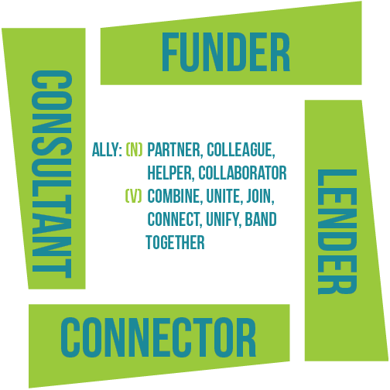
In 2014, Neighborhood Allies
re-launched as a new and improved, 21st century community development intermediary with a renewed and revamped commitment to improving the social and physical infrastructures of Pittsburgh’s distressed and transitional communities.

Slide 4
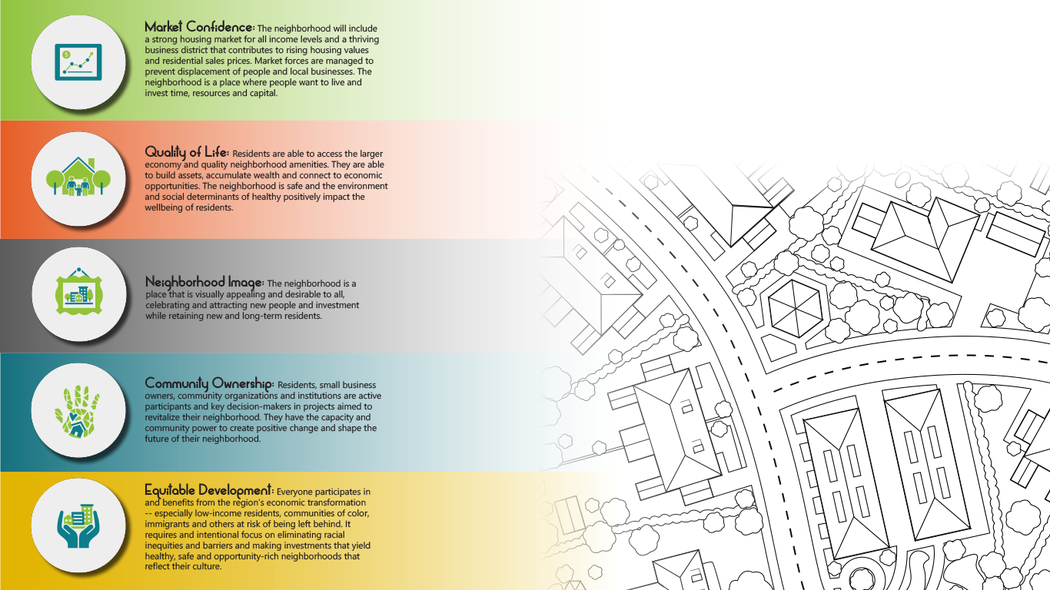
Healthy Neighborhoods Framework

Slide 5


Slide 6
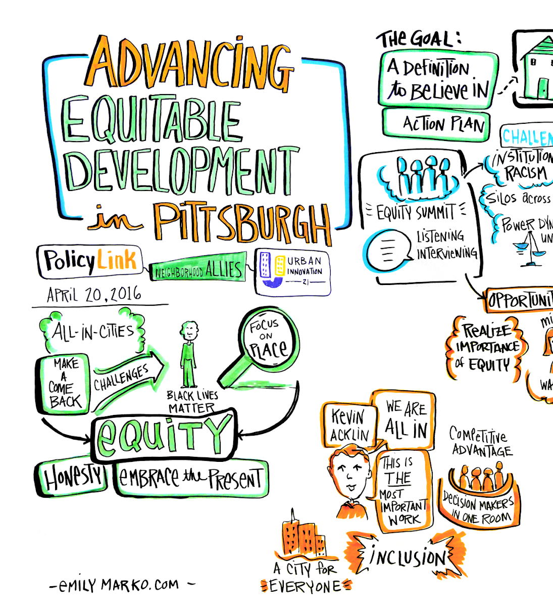
6
Background:
2015 p4 Summit
Equity Summit 2015 Delegation
Interviews, Workshops & Roundtables
UrbanKind Friday Forums
Strategy Workgroups

Slide 7
7
Defining Equitable Development
Equitable development is a positive development strategy to ensure everyone participates in and benefits from our region’s economic transformation—especially the low-income residents, communities of color, immigrants, the disabled and others at risk of being left behind. It requires an intentional focus on eliminating racial inequities and barriers, and making accountable and catalytic investments to ensure lower-wealth residents:
Live in healthy, safe, opportunity-rich neighborhoods that reflect their culture (and are not displaced from them);
Connect to economic and ownership opportunities; and
Have voice and influence in the decisions that shape their neighborhoods.
Notes:
Presley

Slide 8
Equitable Development in Pittsburgh: Moving from Vision to Action
8
An Equitable Development Agenda for Pittsburgh
I. Raise the Bar for New Development
II. Make All Neighborhoods Healthy Communities of Opportunity
III. Expand Employment and Ownership Opportunities
IV. Embed Racial Equity Throughout Pittsburgh’s Institutions and Businesses
V. Build Community Power, Voice, & Capacity

Slide 9
9
Results Based Accountability Framework
Identifies the target population for our efforts
Identifies indicators by which to measure success
Prioritizes strategies to reach results
Target Population: 340,000 people living at or below 200% of AMI, in Allegheny County with an initial focus of 105,000 who live in the City
Notes:
Tracey

Slide 10

10
Core Team:
Roles and Responsibilities
Neighborhood Allies
Urban Innovation 21
Urban Kind
Mongalo-Winston Consulting
PolicyLink
  Lead Convener of the Collaborative
  Provide overall coordination
  Project Management
  Research Support
  Support economic and entrepreneurship components of the work
  Lead the community and resident engagement
  Provide research support
  Plan and lead Action Team meetings
  Help connect to broader equitable development initiatives
  Project management support
  Coordinate the Implementation Team
  Facilitate Steering Committee Meetings, and Assist with Action Teams
  Coordinate policy efforts with development community
  Provides policy research and data
  Advocacy
  Coalition Building

Slide 11
11
Steering Committee:
Committed to date:
Housing Alliance
Pittsburgh United
Action Housing
PNC Bank
Key Bank
Dollar Bank
Buhl Foundation
The Pittsburgh Foundation
The Hillman Foundation
The Heinz Endowments
Chatham: Center for Women’s Entrepreneurship
Partners4Work
The Allegheny Conference
URA
City Planning
City Council District 6
Allegheny County District 10
Office of Mayor William Peduto
Homewood Children’s Village
The Kingsley Association
Trek Development
East End Development Partners
City Commission on Human Relations
Cross-sector partnership: public and private sector, nonprofit, philanthropy, and community orgs.
First convened in August 2017
Action Teams formed
Notes:
Mission:
Establishes the Results Framework, holds us accountable to making progress, can leverage and align resources, remove barriers, and model equitable development.
Who:
A diverse group of respected leaders across various sectors that are committed to advancing racial equity and equitable development throughout Pittsburgh.
Membership Commitment:
One year (quarterly meetings)

Slide 12
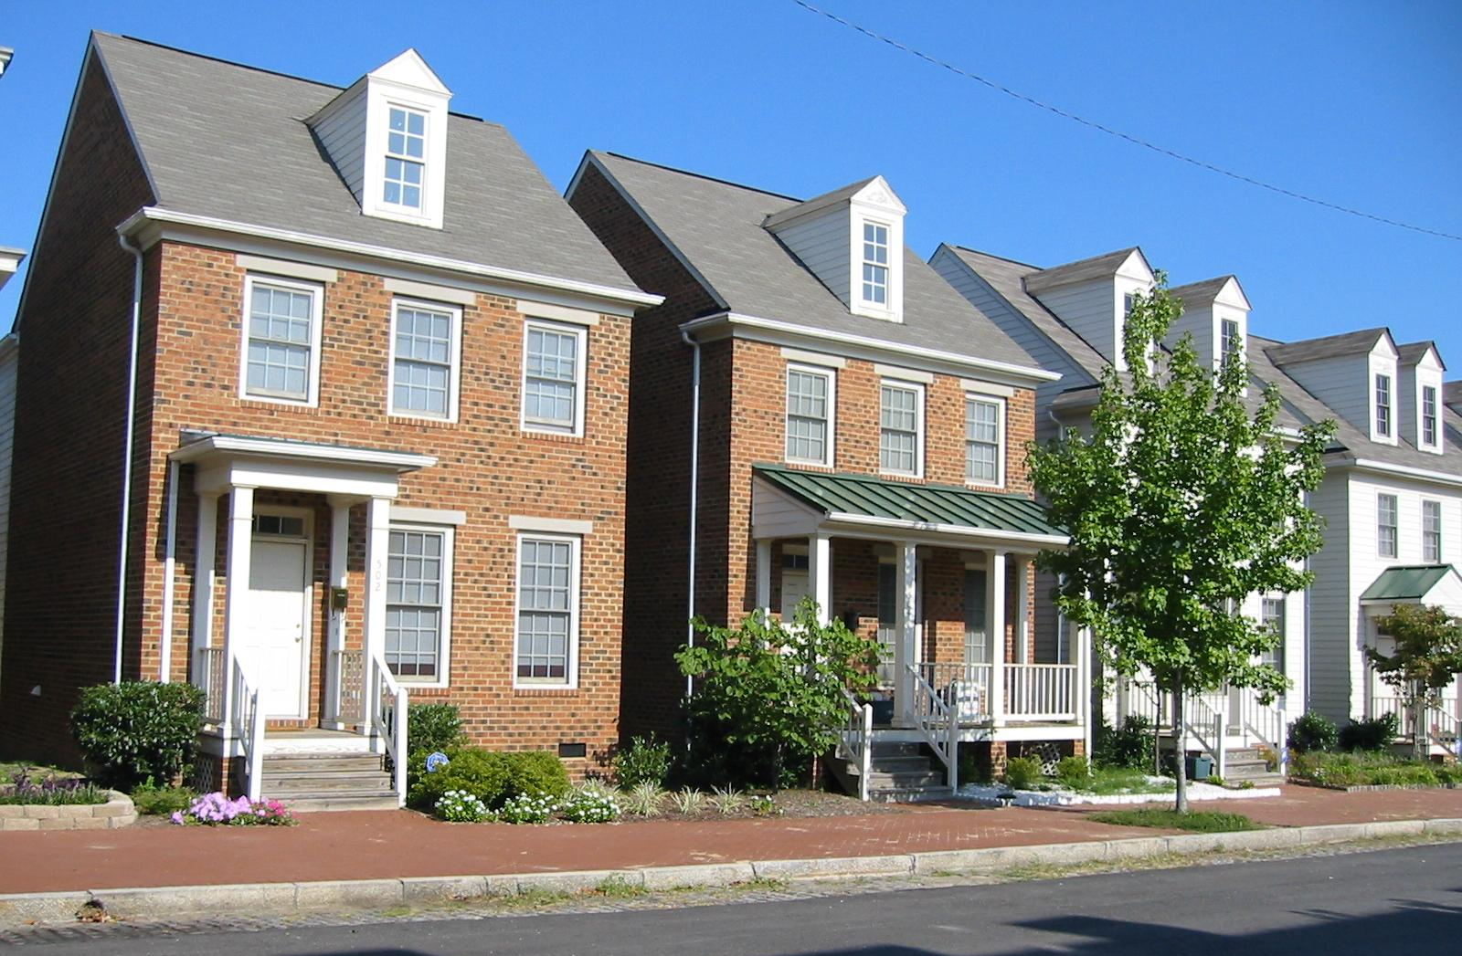
12
Housing Action Team
Indicators
Housing burden for renters and owners (share paying 30% of income on housing costs)
Homeownership rate in opportunity rich neighborhoods
  Residents are more able to stay in their neighborhood. Indicates stable income and ability to buy; demonstrates a commitment to invest in the neighborhood
The number of affordable housing units (available to households at or below 80%, 50% and 30% of AMI)
  Ensure that there is affordable housing in all neighborhoods, not just neighborhoods of last resort; ensure that neighborhoods offer desirable amenities including connection to transit

Slide 13
13
Housing Action Team
Priorities: 2018-2019
Advocate for the creation of a new PA Housing Tax Credit (Policy)
  Led by the Housing Alliance of PA; will provide a new source of funding for affordable housing.
Implement a tenant protections policy to enhance tenants’ ability to stay in safe, quality housing (Program/Policy)
  Work with local partners to identify best practices and appropriate local models
Encourage broader use of p4 metrics with a specific focus on the equity metrics (Education & Advocacy)
  In addition to the URA, developers (including Action Housing) can use the metrics as a reference tool.

Slide 14
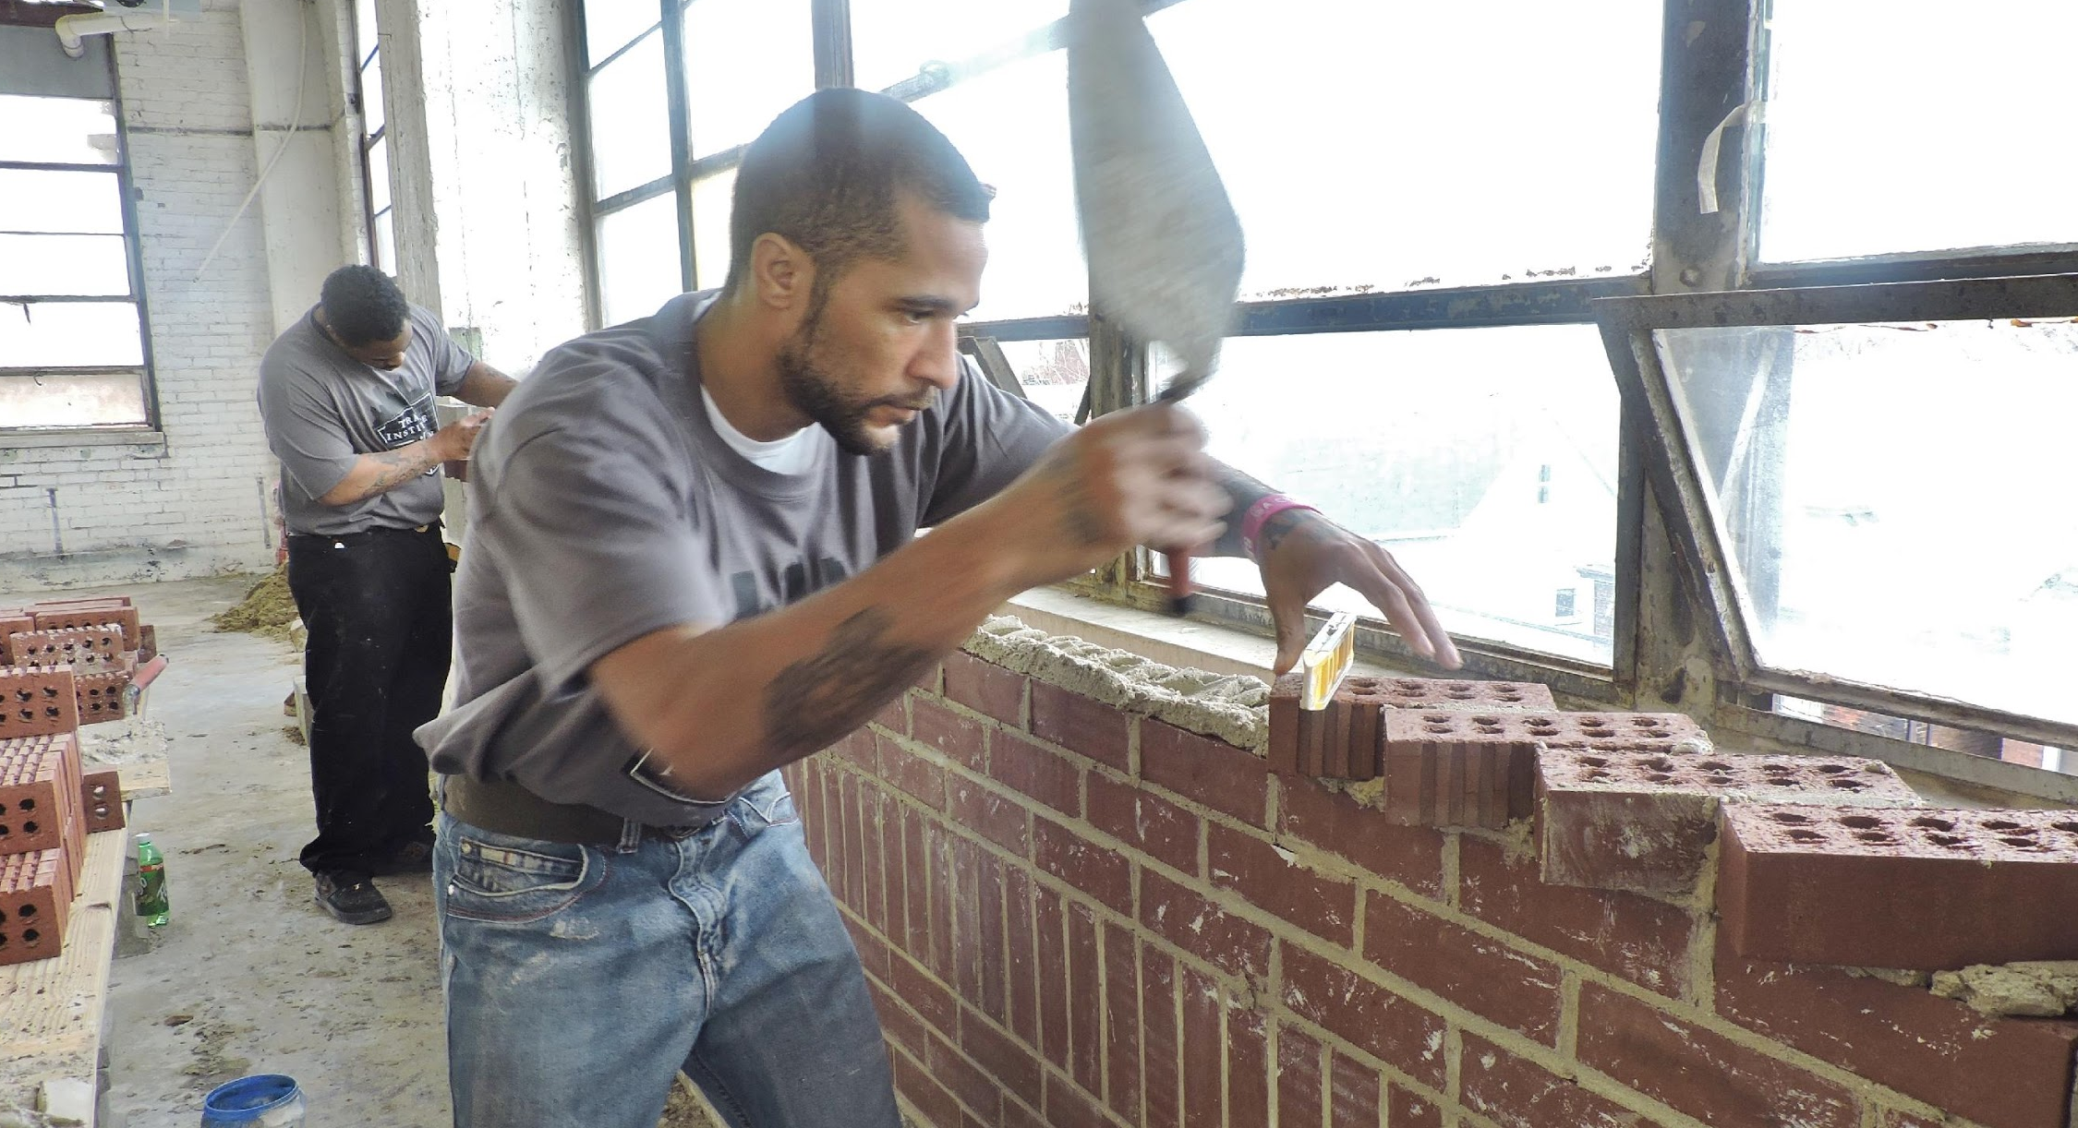
14
Employment & Entrepreneurship Action Team
Indicators
Percentage of residents living at or below 200% of Poverty
Jobless rate (share of working-age population not currently employed)
Number of minority-owned businesses
  In subsequent years we would like to track jobs being created by minority businesses

Slide 15
15
Employment & Entrepreneurship Action Team
Priorities: 2018-2019
Change hiring behavior at organizations & corporations (Systems Change)
  Confirm commitments from Steering Committee members to implement the Rooney Rule in hiring and purchasing (within one year)
  Advance equity within organizations by assessing and implementing a tracking tool such as the Sustainable Pittsburgh Challenge with a broader cohort of organizations
Increase access to capital
  Work with participating banks to create more funding opportunities for minority entrepreneurs
  Promote the URA’s micro enterprise loan program

Slide 16


Thank You!

